Slide 1



Chip-scale simulation of residual layer thickness uniformity in thermal NIL: evaluating stamp cavity-height and
‘dummy-fill’ selection strategies
15 October 2010
Hayden Taylor and Duane Boning
Massachusetts Institute of Technology
Andrew Kahng and Yen-Kuan Wu
University of California, San Diego

Slide 2
Residual layer thickness in thermal NIL exhibits pattern dependencies
  A common objective for
  nanoimprint-friendly design:
  Limit time to fill cavities and to bring residual layer thickness variation within specification
  Two relevant timescales
  for pattern formation:
      Local cavity filling
  NIL for planarization
  Similarly, limit time to bring NIL-planarized surface within spec.
  Stamp
  Planarizing material
      Residual layer thickness
      (RLT) homogenization
  Substrate

Slide 3
Semiconductor designers are accustomed to satisfying pattern density constraints
  Not realistic
  in semiconductors
  Pattern density already constrained to a modest range (typ. 40-60%)
  → Insert non-functional (‘dummy’) features on the stamp

Slide 4
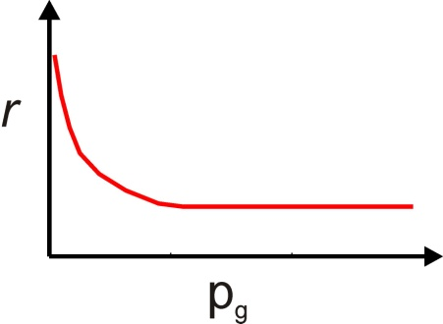
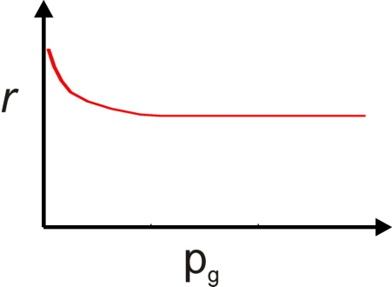
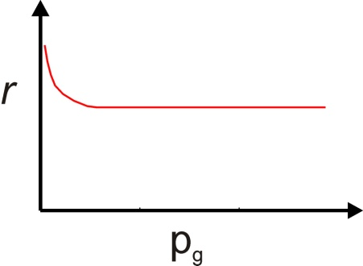
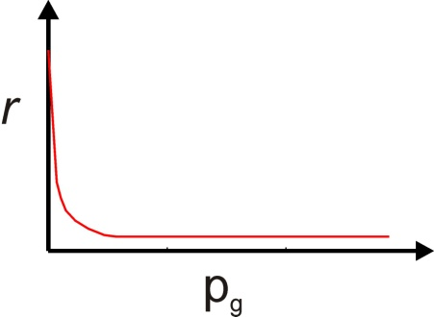
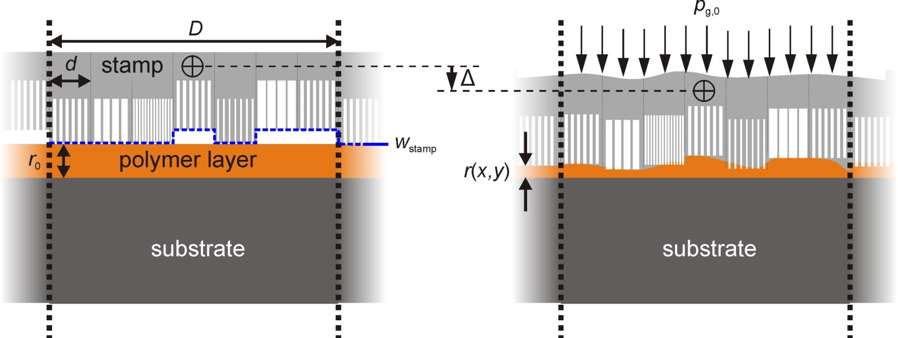
We use simulation to investigate the potential benefit of dummy fill to thermal NIL
Local relationships between pressure history and RLT:
Abstractions:
Stamp: point-
load response
Resist: impulse
response
Wafer: point-load
response
HK Taylor and DS Boning, NNT 2009; SPIE 7641 (2010)

Slide 5
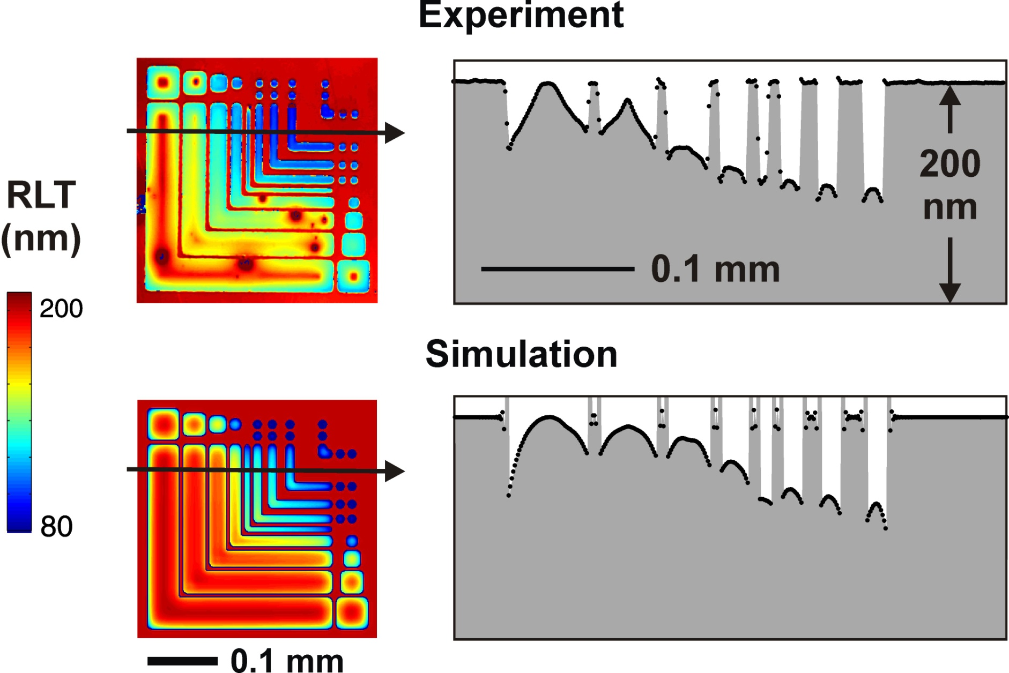
Our NIL simulation technique has been experimentally validated
PMMA 495K, c. 165 °C, 40 MPa, 1 min
HK Taylor and DS Boning, NNT 2009; SPIE 7641 (2010)

Slide 6
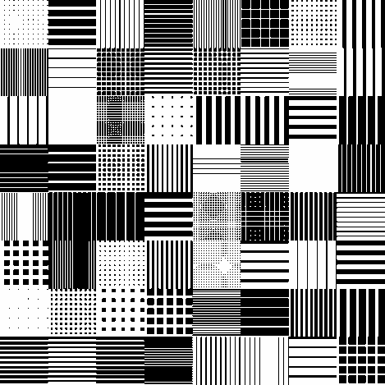
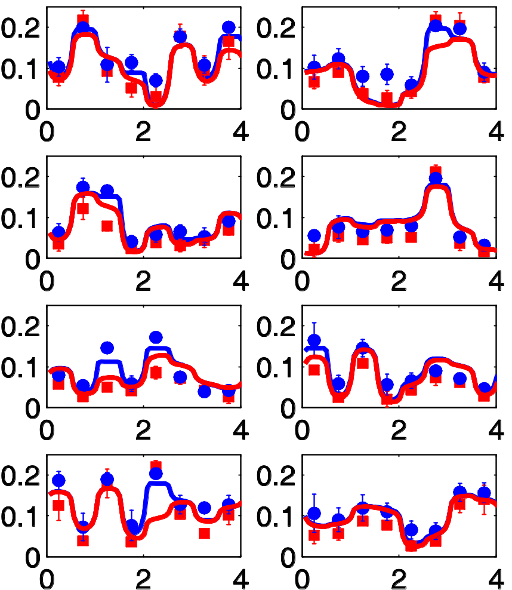
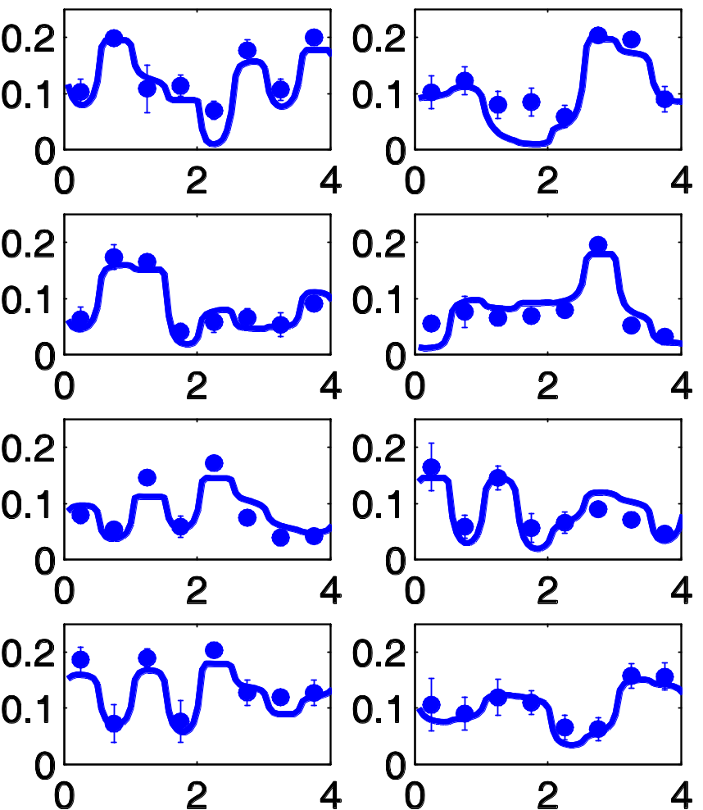
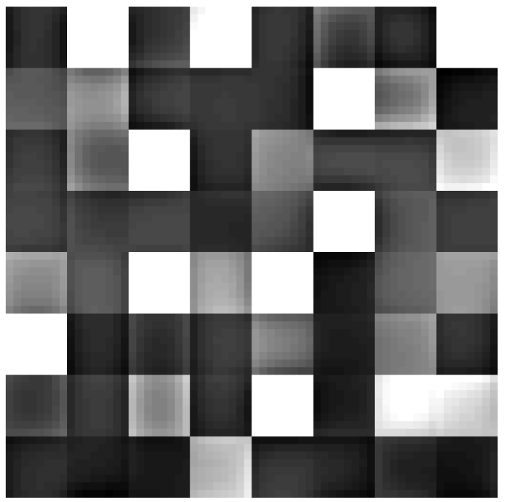
Our NIL simulation technique has been experimentally validated
PMMA 495K (200 nm), 180 C, 10 min, 16 MPa, 10 replicates
550 nm-deep cavities:
Exp’t
Simulation
Si stamp
A
B
cavity
protrusion
C
D
1 mm
A
Residual layer thickness (micron)
B
E
F
C
D
E
F
G
H
G
H
Cavity proportions filled
Lateral position (mm)
Notes:
An example of the data captured: section through a test sample. For PMMA, we capture successfully model filling of cavities, and the method works both just above Tg and 30 C above it.

Slide 7
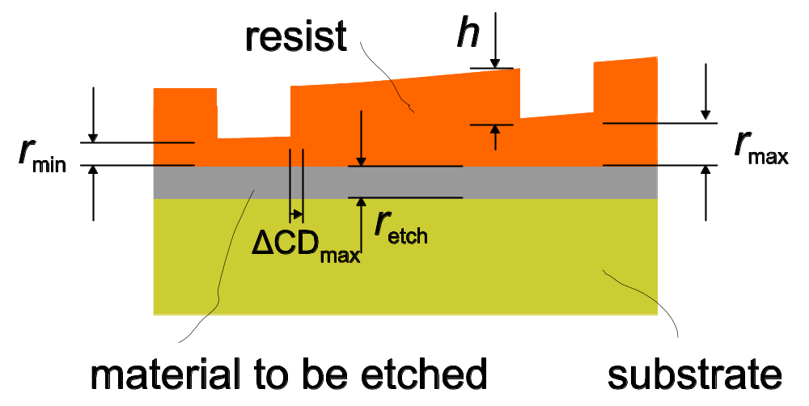
If imprinted layer is an etch-mask, RLT specifications depend on resist properties
(h + r_{max})/r_{max} must be large enough for mask to remain intact throughout etch process
Largest allowable r_{max} – r_{min} is likely determined by lateral etch rate and critical dimension specification

Slide 8
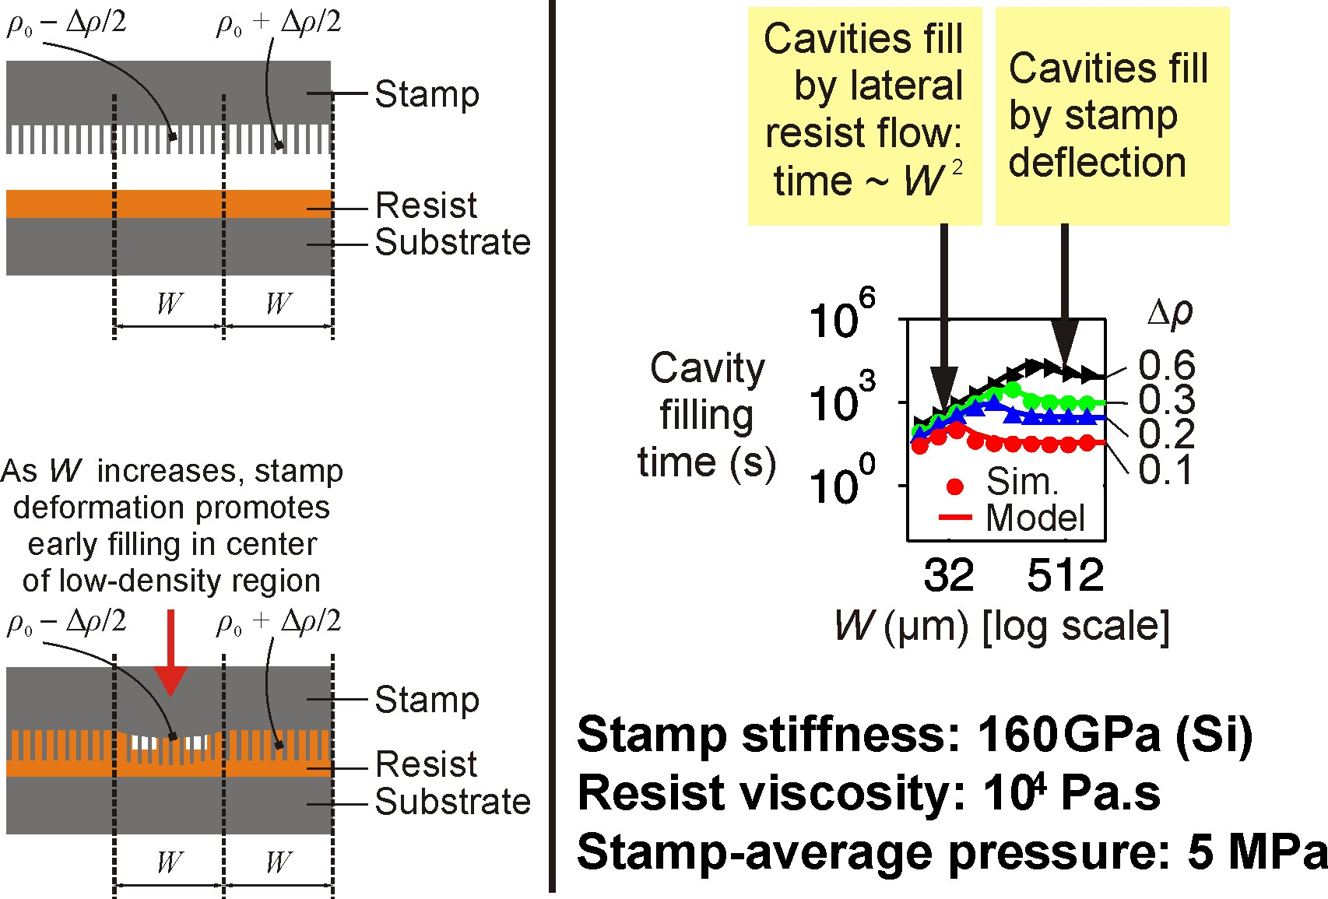
Cavity-filling time depends on length-scale of pattern-density variation, and stamp stiffness
Notes:
Now an accusation often levelled at spun-on nanoimprint is that it can’t cope with isolated lines: the resist surrounding them has nowhere to go. But this situation just isn’t realistic in semiconductor manufacturing: there are already pretty stringent restrictions on spacing and density, imposed, for example, by the physics of chemical mechanical polishing. So what I’m saying is that pattern dependencies don’t need to be a killer for nanoimprint: we just need to understand them.

Slide 9
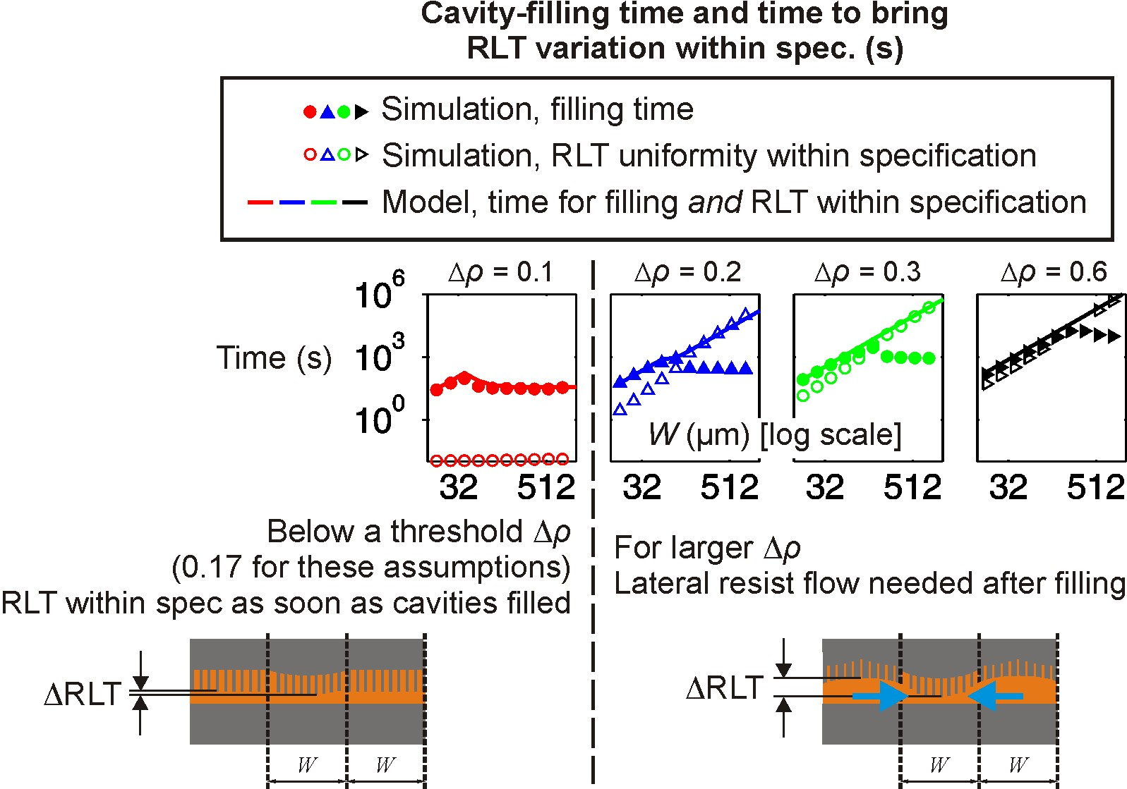
Time to satisfy target for RLT uniformity scales as ~W² for Δρ above a threshold
Notes:
Now an accusation often levelled at spun-on nanoimprint is that it can’t cope with isolated lines: the resist surrounding them has nowhere to go. But this situation just isn’t realistic in semiconductor manufacturing: there are already pretty stringent restrictions on spacing and density, imposed, for example, by the physics of chemical mechanical polishing. So what I’m saying is that pattern dependencies don’t need to be a killer for nanoimprint: we just need to understand them.

Slide 10
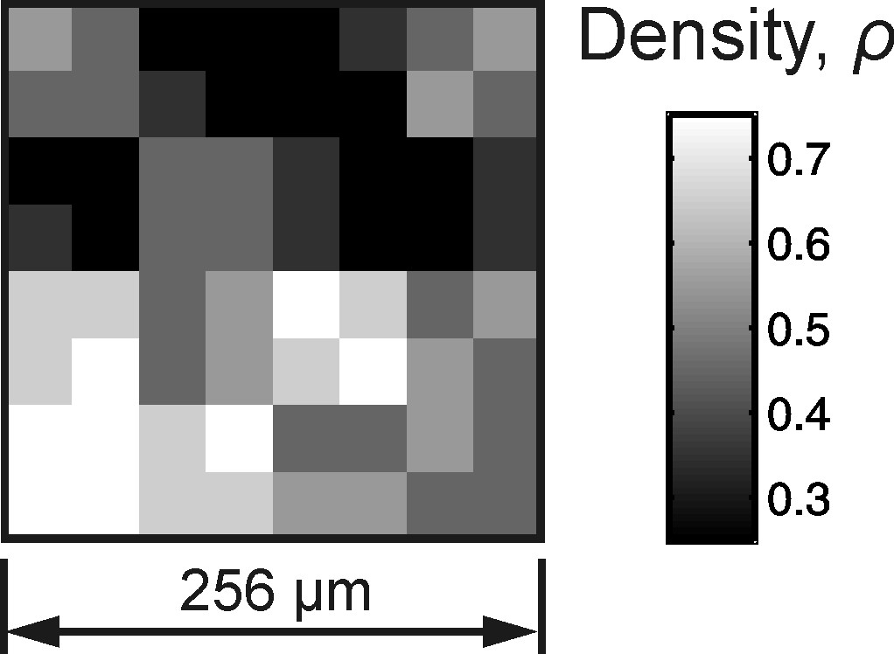
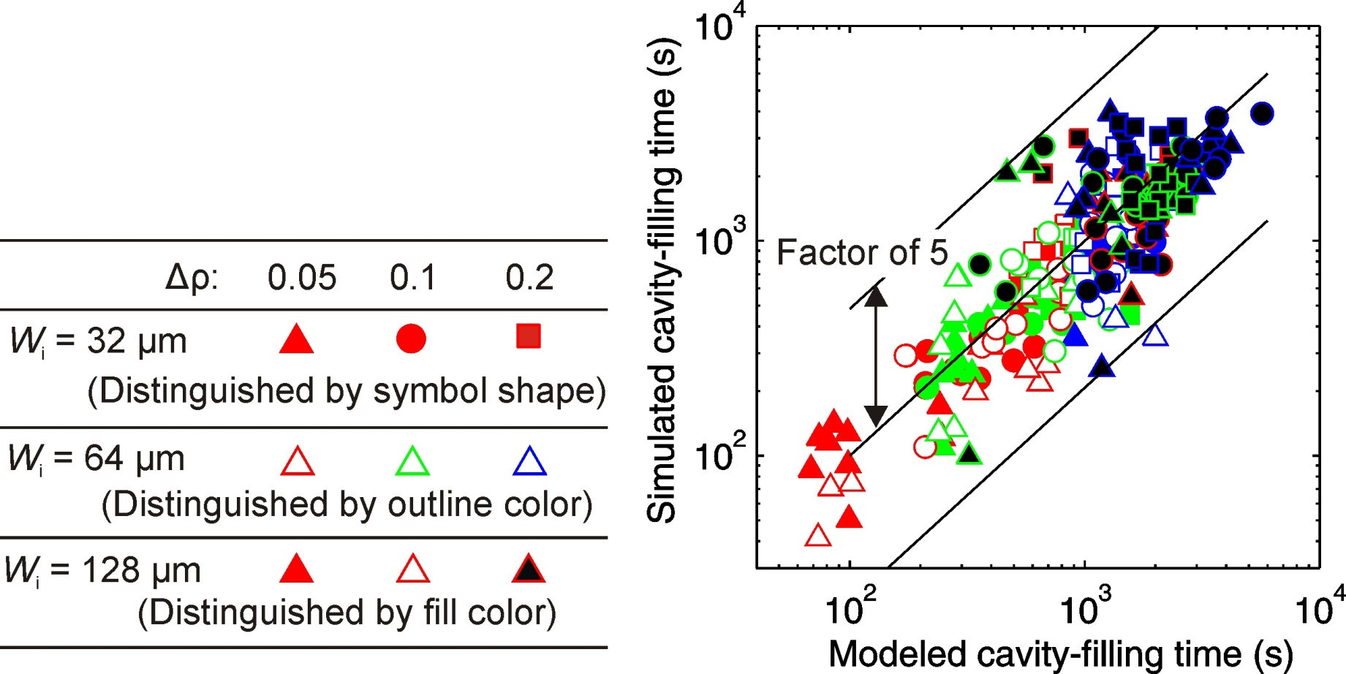
We postulate a cost function to drive the insertion of dummy fill into rich designs
W_{i}
Abutting windows of size W_{i} swept over design
Δρ_{i} is maximal density contrast between abutting windows in any location
Objective is to minimize sum of contributions from N+1 window sizes
h: protrusion height on stamp
r₀: initial resist thickness
Notes:
Now an accusation often levelled at spun-on nanoimprint is that it can’t cope with isolated lines: the resist surrounding them has nowhere to go. But this situation just isn’t realistic in semiconductor manufacturing: there are already pretty stringent restrictions on spacing and density, imposed, for example, by the physics of chemical mechanical polishing. So what I’m saying is that pattern dependencies don’t need to be a killer for nanoimprint: we just need to understand them.

Slide 11
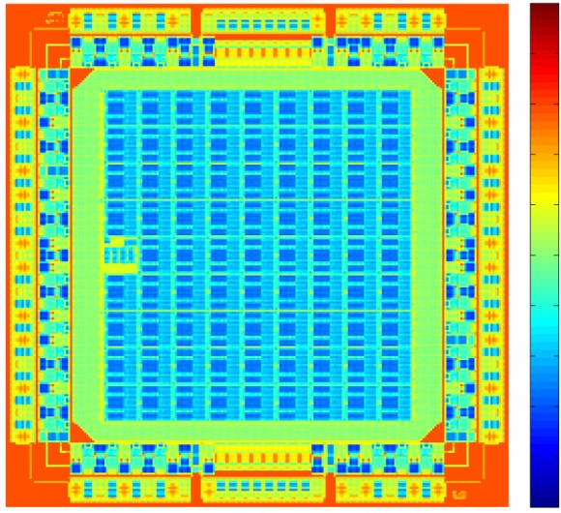
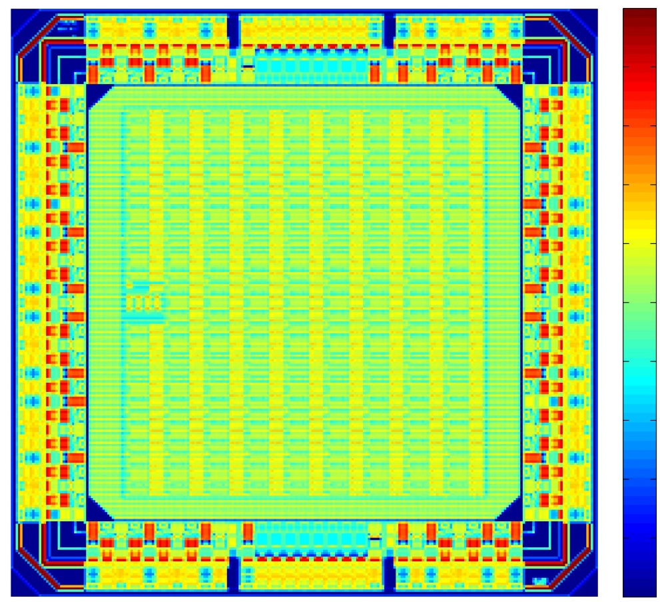
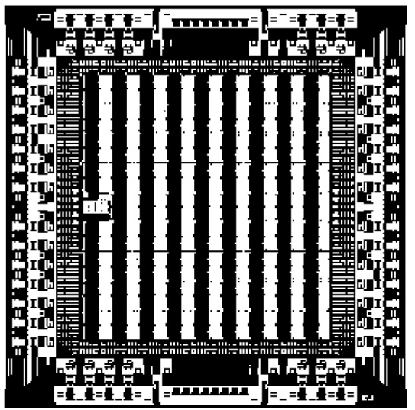
A simple density-homogenization scheme offers faster filling and more uniform RLT
Metal 1 of example integrated circuit: min. feature size 45 nm
Characteristic feature pitch (nm)
10⁴
Stamp protrusion pattern
density: without dummy fill
1
10³
10²
0.5
Predominant feature orientation
0
100 µm
Notes:
Now an accusation often levelled at spun-on nanoimprint is that it can’t cope with isolated lines: the resist surrounding them has nowhere to go. But this situation just isn’t realistic in semiconductor manufacturing: there are already pretty stringent restrictions on spacing and density, imposed, for example, by the physics of chemical mechanical polishing. So what I’m saying is that pattern dependencies don’t need to be a killer for nanoimprint: we just need to understand them.

Slide 12
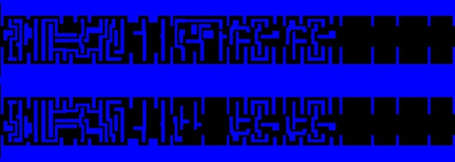
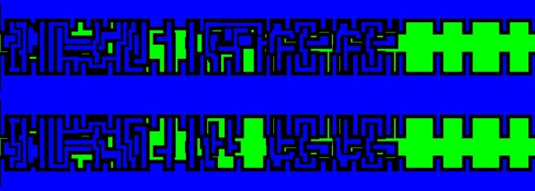
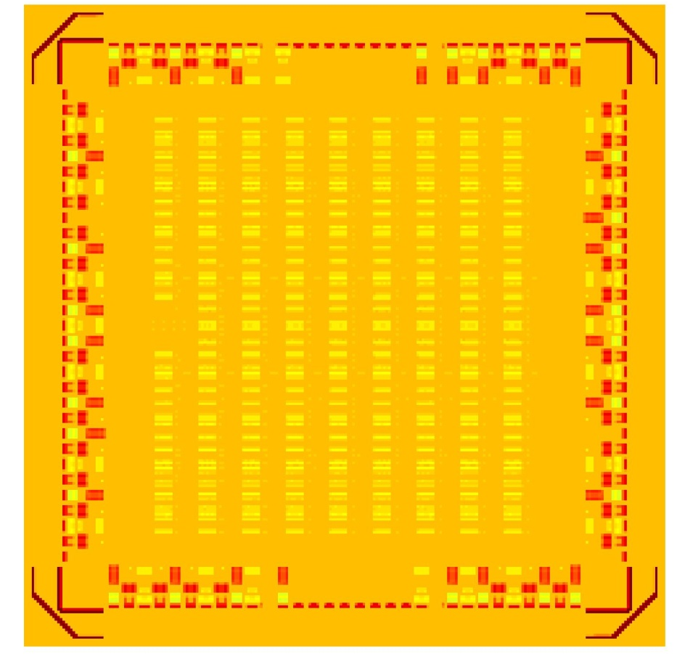
A simple density-homogenization scheme offers faster filling and more uniform RLT
Density: without fill
Density: with fill
Designed protrusion
Available for dummy
1 µm
1
0.5
100 µm
0

Slide 13
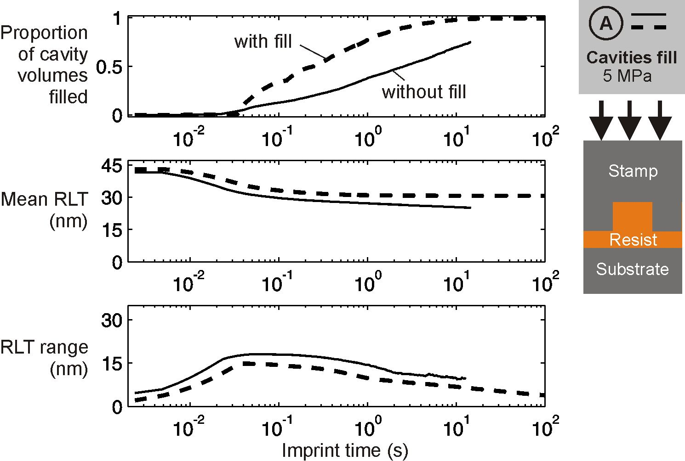
A simple density-homogenization scheme offers faster filling and more uniform RLT

Slide 14
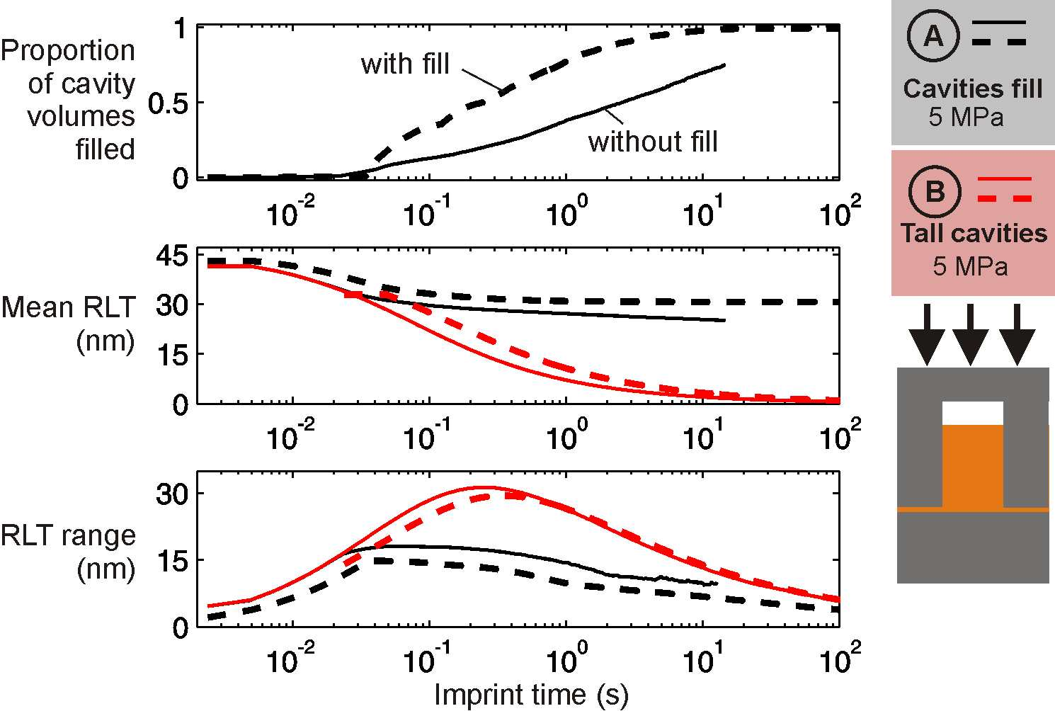
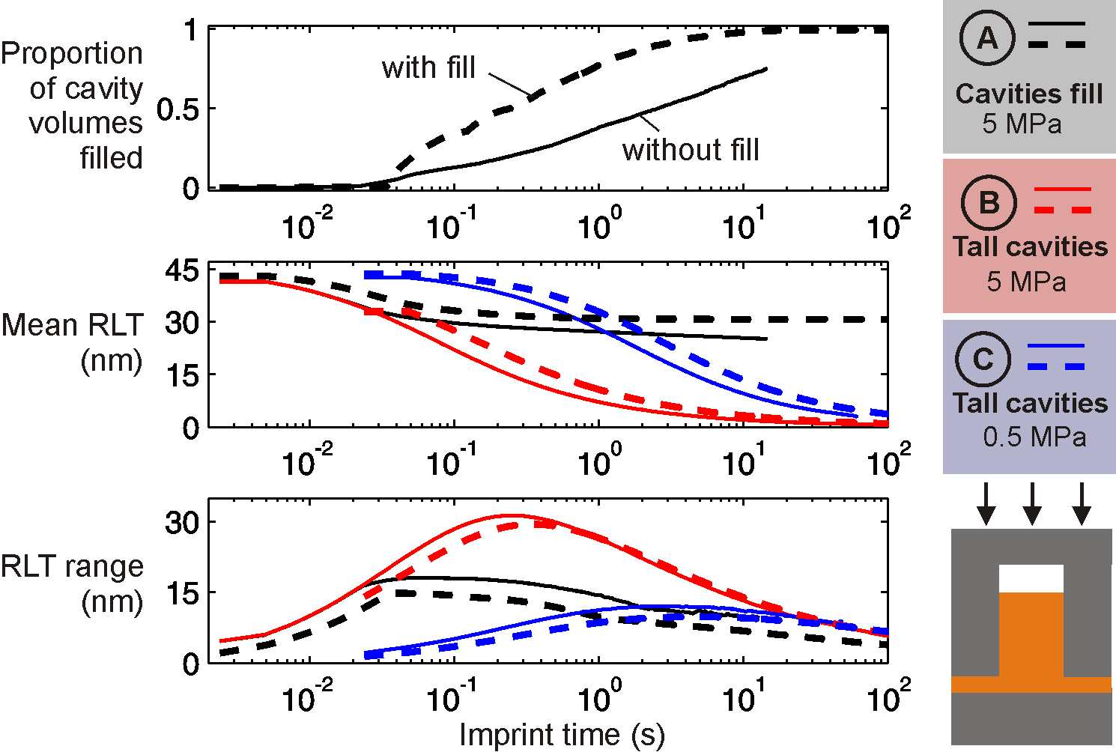
If stamp cavities do not fill, smaller RLTs are possible but RLT may be less uniform

Slide 15
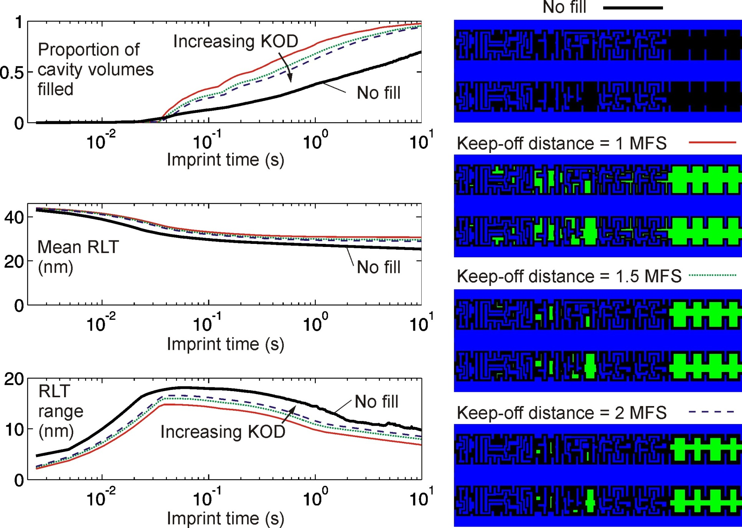
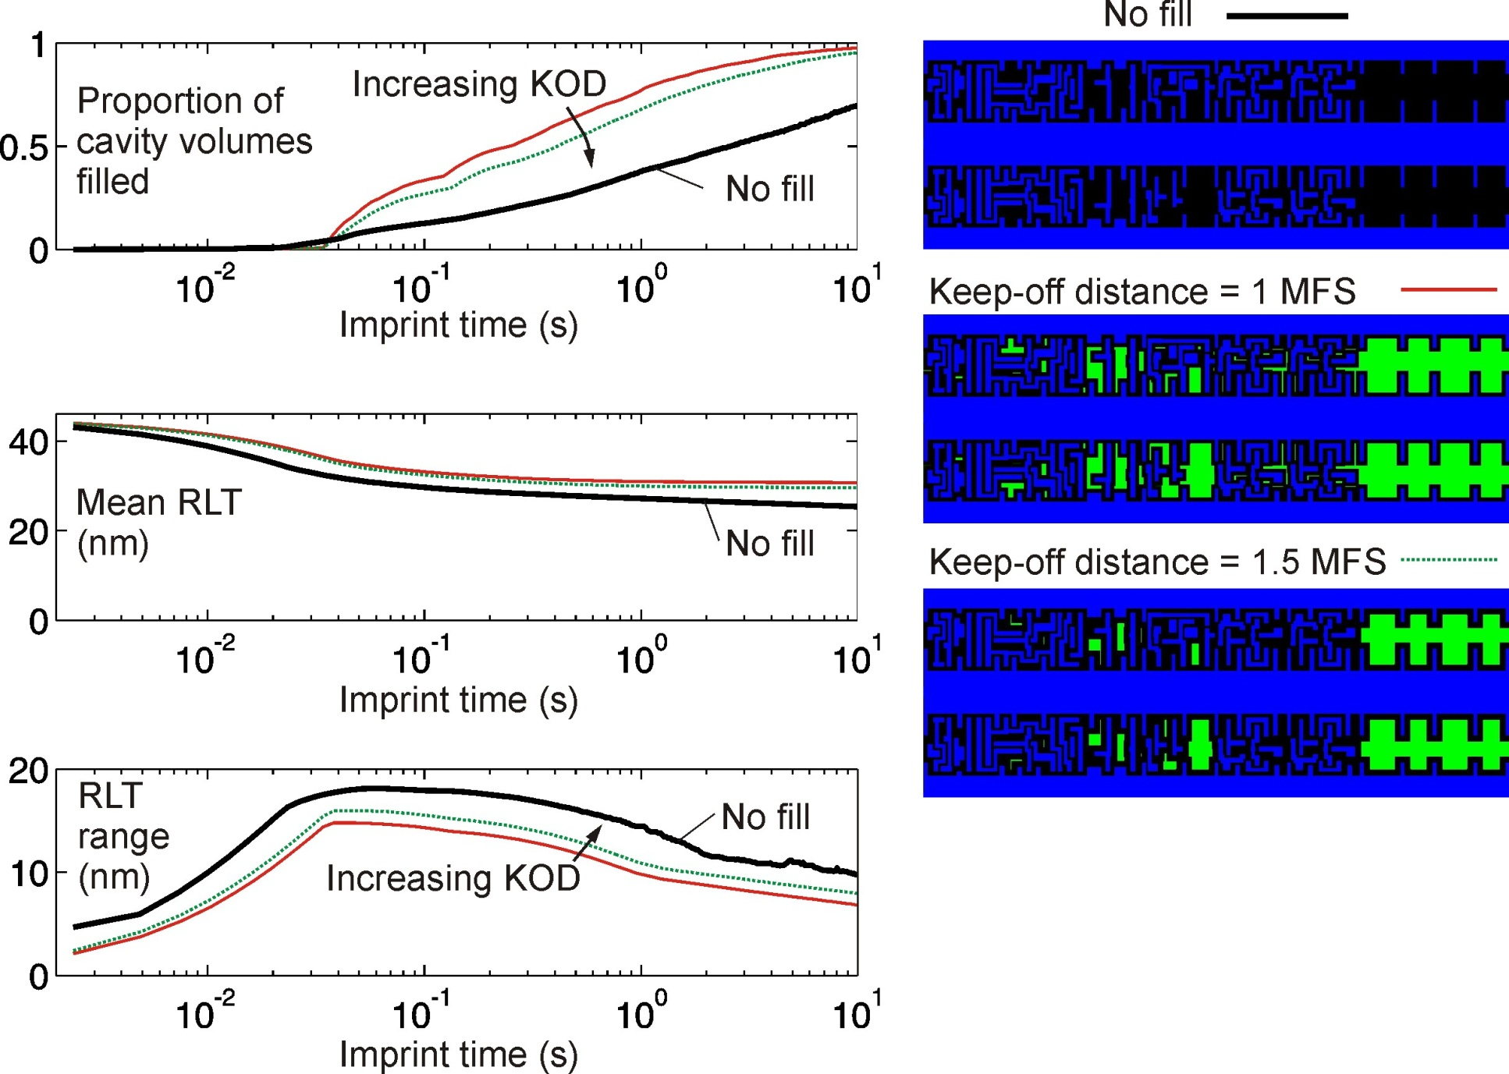
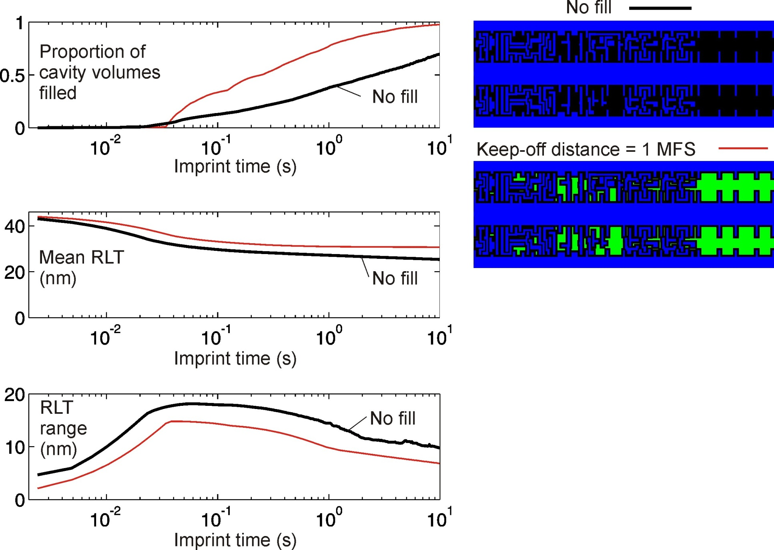
Increasing ‘keep-off’ distance may reduce IC parasitics, but degrades RLT performance
MFS: minimum feature size
KOD: keep-off distance
IC: integrated circuit

Slide 16
Summary
Simulations indicate that dummy-fill can accelerate cavity-filling and reduce RLT variation in thermal NIL
A plausible objective function has been proposed, to help minimize filling time and RLT variation
Tall, non-filling stamp cavities permit smaller average RLT but not necessarily greater uniformity
Spacing rules for NIL fill insertion may need to be far more aggressive than for existing IC dummy fill

Slide 17
Outlook
In an integrated circuit design with multiple layers, fill insertion will ideally be co-optimized for all layers
Dummy-fill is just one of several possible Mechanical Proximity Correction¹ strategies:
  Insert dummy fill based on density alone (as here)
  Tune dummy feature shapes and sizes, as well as density
  Manipulate feature edges in the non-filling cavity case
¹ HK Taylor and DS Boning, NNT 2009; SPIE 7641 (2010)

Slide 18
Acknowledgements
Funding
  The Singapore-MIT Alliance
Colleagues
  Matt Dirckx, Eehern Wong, Melinda Hale, Aaron Mazzeo, Shawn Chester, Ciprian Iliescu, Bangtao Chen, Ming Ni, and James Freedman of the MIT Technology Licensing Office
Helpful discussions
  Hella Scheer, Yoshihiko Hirai, Kristian Smistrup, Theodor Kamp Nielsen, Brian Bilenberg, and Dave White.

